Slide 1
RiskMeter 2.0
Training

Slide 2
Why Use RiskMeter Online™
RiskMeter empowers underwriters, brokers, agents, and other businesses with comprehensive natural hazard risk information at your fingertips.
Over 70 natural hazard risk and building specific reports
Intuitive and easy-to-use visualizations with Google Maps integration
Detailed and comprehensive risk overlays to easily recognize the scope of any hazard at the property level
Complete peril-based solutions giving the user a holistic view of hazard risk
Accessible via the web or through API integration with your Policy Admin System (PAS)
Online batch solution offers the ability to calculate risk for multiple properties in a single submission
Affordable transaction-based pricing meaning you only pay for the reports you need
Trusted and used by industry leaders

Slide 3
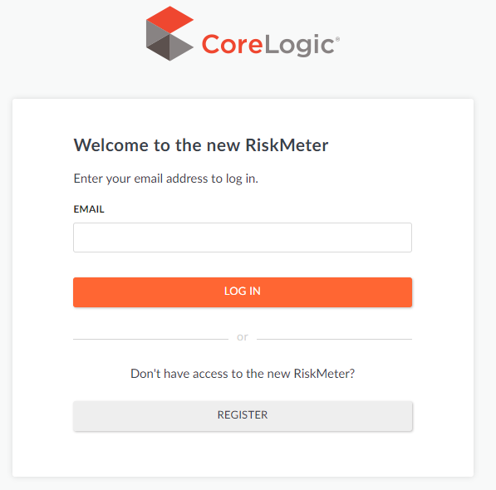
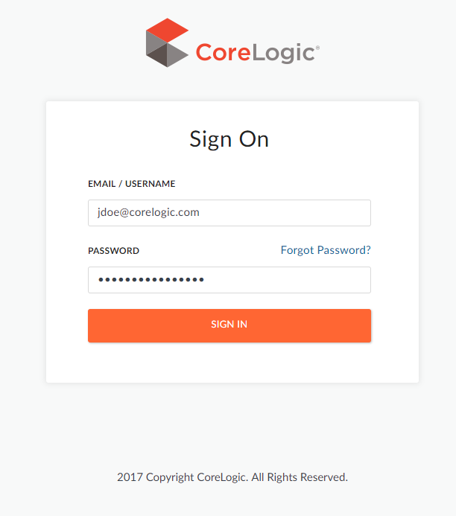
Getting Started
https://riskmeter.corelogic.com
Enter Username
  Click login
Enter Password
  Click sign in

Slide 4
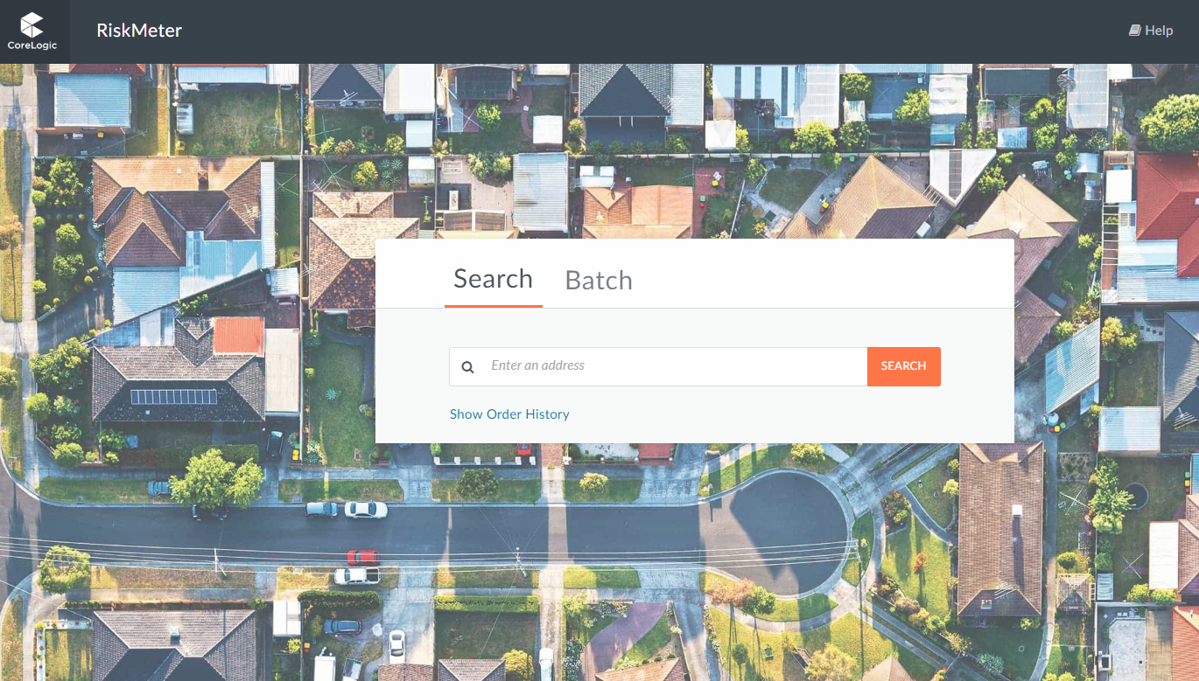
Searching for a Property
by Address
Enter a complete, valid address
  Street number, city, state, zip (zip is option but could provide better results)

Slide 5
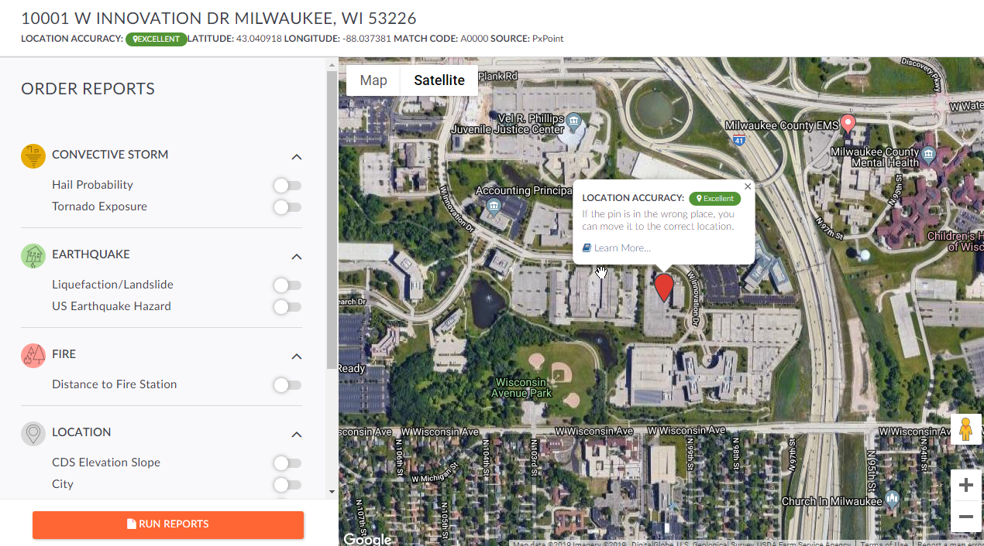
Address Verification & Report Selection Page
Address is matched and standardized
  Standardizes address
    Abbreviates street suffix
    Fixes spelling errors
    Finds zip code +4
  Always verify the address returned is the correct address.
    **Note: addresses returned may have a different city or zip code, if RiskMeter was unable to find a match with the input information.

Slide 6
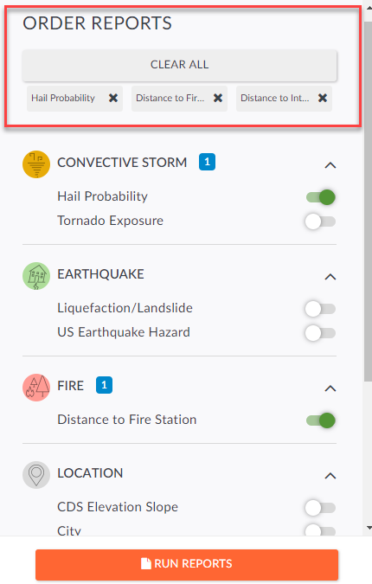
Report Selection
Report Listing
  Only those available for the entered location
  Charged only for ordered reports
  Top section indicates which reports have been selected

Slide 7
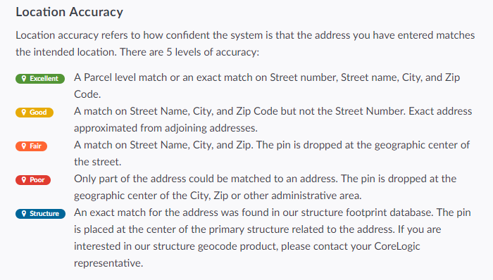
Location Determination
Geocoding – the process of taking an address and locating a specific point on the earth where the address is located.
Powered by PxPoint™, our enterprise-level geocoder.
  Unique from other geocoding systems, PxPoint can simultaneously query multiple data sets, such as U.S. parcel boundaries, structure footprints, and premium street data, to return the best match possible.
  Largest parcel database available with 145+ million parcels and 86+ million structure footprints
PxPoint will only return a geocode result it is confident in, if a result is not found please check the validity of the address.

Slide 8
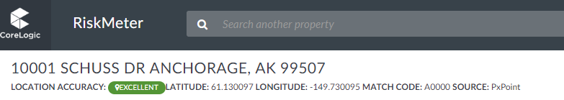
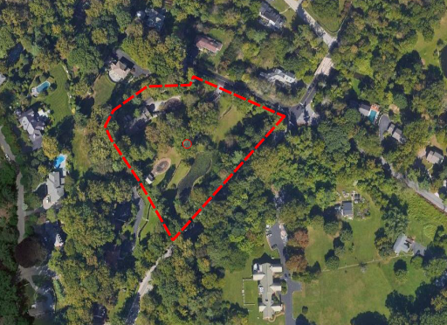
Location Accuracy
Structure vs Excellent vs Good
Structure
Excellent
Good
Notes:
700 OLD GULPH RD BRYN MAWR, PA 19010

Slide 9
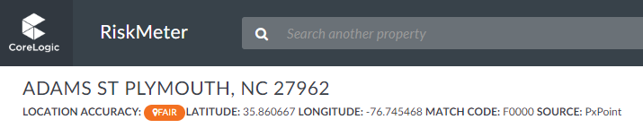
Location Accuracy
Non-Confident Georesults
RiskMeter will not provide risk information if a location cannot be found
  These are not considered accurate matches
  No information is better than the wrong information!
Possible reasons for Fair or Poor results
  Input address missing key elements (street number, or is a PO Box/Rural Route)
  Zip codes change often
  Many streets have more than one name
  New developments and subdivisions may not be mapped out yet
Notes:
ADAMS ST PLYMOUTH, NC 27962

Slide 10
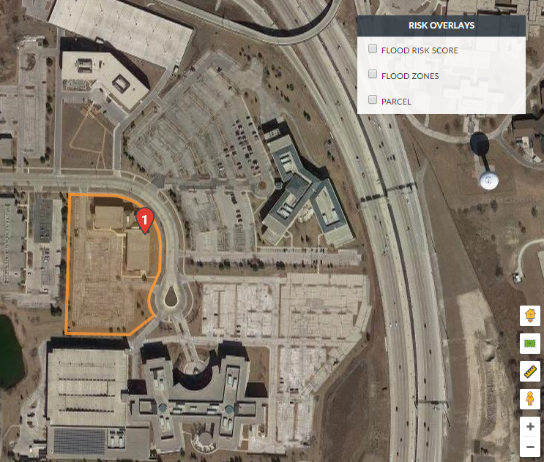
Map Functions
The map will
Risk Overlays
  Ability to view risk layers*
    *only available for some reports
Toolbar
  Zoom in/out
  Street View
  Measure

Slide 11
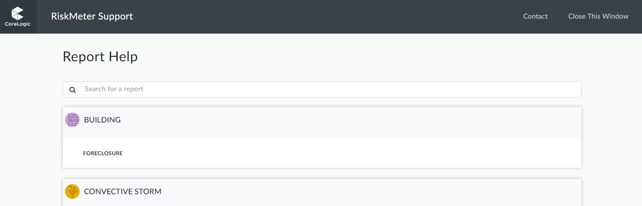
Tips and Tricks
Download PDF
Help documentation

Slide 12
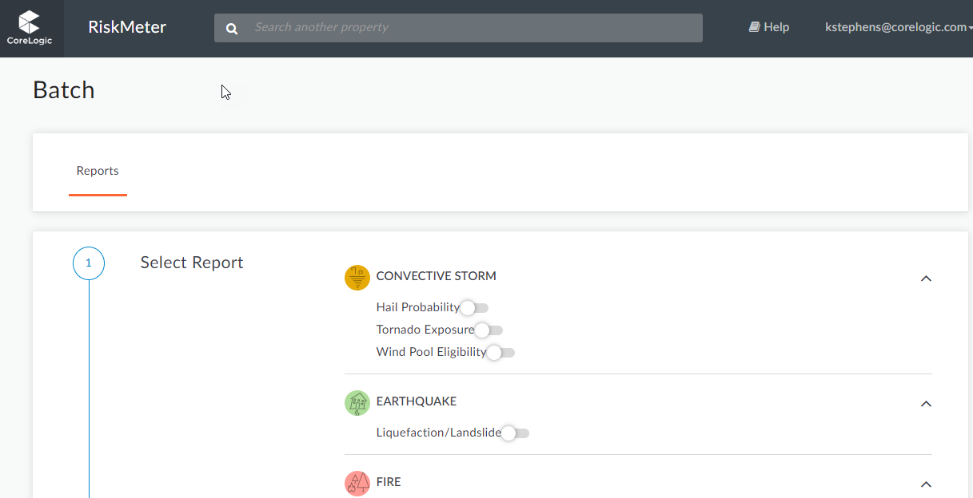
Batch
Any RiskMeter report can be run in a batch
This means you can submit schedules of addresses for analysis and receive results in a spreadsheet format.
  Grouped policies, book of business, etc.
  Approx. 30,000 addresses can be ran at one time
Online service is available that requires no human intervention – results are returned in minutes!
Templates available for download

Slide 13
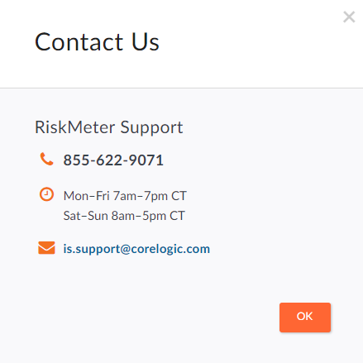
Questions
Customer Service:
  (855) 622-9071
  is.support@corelogic.com
Sales Support:
  Call your Account Representative or
  (855) 622-9071

