Slide 1
Program NRN Reports
Expiration to ODEN Report Comparison

Slide 2
Monthly Expiration Reports
A monthly Div 66 Expiration report is provided to the Ops team
  The report is run 90 days in advance of the current month, therefore the February 2019 report will contain the expiring policy information for May 2019

Slide 3
ODEN Policy Terminator Reports
Individual ODEN reports will be run, by Operations, by PA and Program
  The reports are currently run with the From date of 01/01/2018
  The To date will be one month after the expiration list date, so for the May expiration list the To date will be 6/30/2019
    This will allow us to see all notices created with mail dates from 1/1/2018 through 6/30/2019

Slide 4
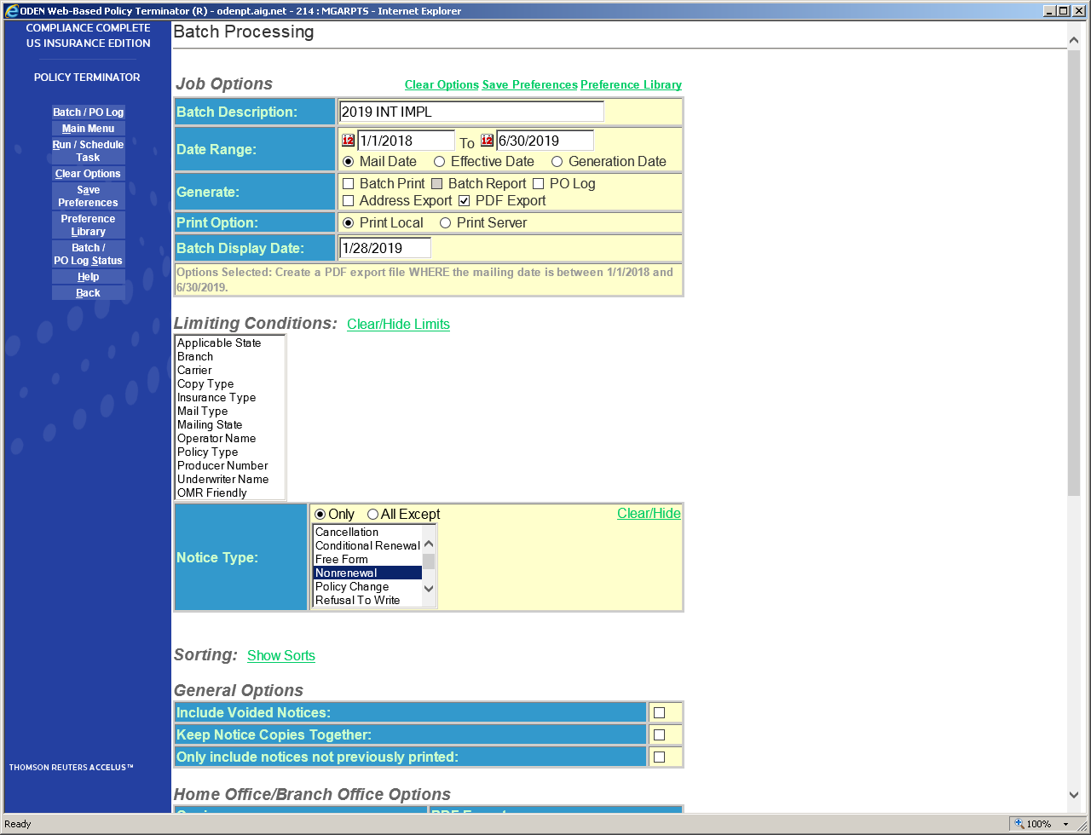
The ODEN report will be set up to provide all Non-Renewal Notices created with Mail Dates between 1/1/2018 and 6/30/2019

Slide 5
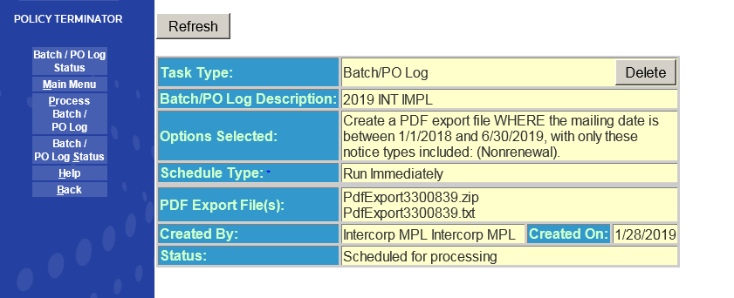
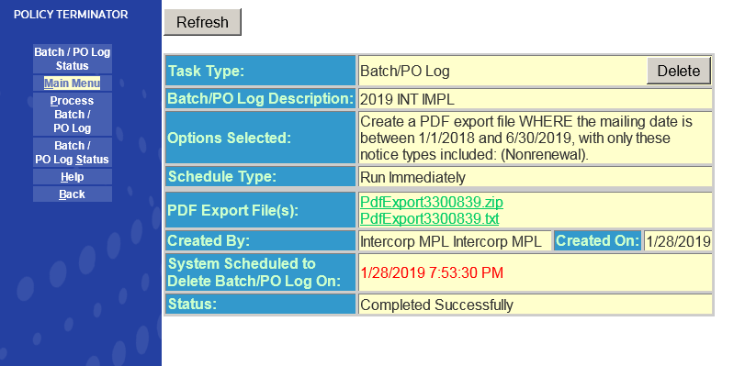
This sets up the report, which is then Refreshed to create the final report
Right clicking the txt report allows it to be placed into Excel format

Slide 6
Expiration to ODEN Report
The Expiration report is copied into the Expiration to ODEN Report on the Expiration tab
The ODEN NRN report is then converted to Excel and copied to this report on the ODEN tab
  A function is then run and reviewed to create a comparable policy number between the two reports

Slide 7
Final NRN Report
The Expiration tab of the report is then sorted by the specific PA and Program being reviewed
The final report is then uploaded to the zshare
  Zshare>PA Management>~TERMINATED PA NRN REPORTS
The final reports are placed in folders named MM-YYYY and each report is named using the following format
  Month-Year PA Ticker Program Ticker
  For the April Intercorp/Intercorp MPG report the name would show as:
  04-2019 INT IMPL

Slide 8
Report Overview
The Final Comparison Report will contain a list of all policies set to expire during the specific month of the report
There are 4 additional columns to the far right of the report
The first 3 provide the State Rules by LOB
The last column provides either the Mail Date of the ODEN Notice or #N/A which means no notice was found
Notes:
The Policy Expiration report comes out 90 days in advance of the expiration date of the policies.
For Commercial Lines policies the most advanced days notice is 75 days notice, with the exception of SC which has specific rules for short term policies, but otherwise the rule s 60 days notice.
For Auto Lines the most is 75 days notice, all exceptions pertain to notification of the DMV in specific states, but again nothing more than 75 days advance notice is required.
For Excess Lines the most is 75 days notice for lines other than WC.
We do not provide WC, but if it is somehow included in the Package policies the notice time can be up to 120 days advance notice.
This will allow up to 15 days turn around on the report, review and notice to the PA that a notice needs to be created. Most of the states are 60 or less, so I believe we should be good with the report being run 90 days in advance of the expiration date of the policies.

Slide 9
Review
It has come to my attention during this process that not all PAs are using the AIG ODEN PT system
The ODEN Policy Terminator system provided to each PA by AIG is the system on which these notices should be created
  If for some reason your PA is not using this system, we have no way of tracking their notices
  We also have no backup should a terminated PA be sold or go out of business unless the notices are on our version of the system
  It would be extremely helpful if the PMs could request the name of the ODEN PT GROUP under which each of the terminated programs notices are being created, and there are some PAs who seem to have multiple unspecified ODEN Groups

Slide 10
Next Steps
It will be up to the Program Manager to review the results of the monthly report
  The mail date should be confirmed as falling within the State Rules
  The PA should be requested to provide an explanation of the lack on notice on those accounts that show the #N/A result
    Acceptable reasons would be if the account was previously cancelled or extended beyond the noted expiration date
  The PA should require that a notice be created on any accounts where the PA can not provide an acceptable
    State Rules and Regulations should be confirmed by the PA if extension of the policy would be necessary to meet the requirements
      Some states do not allow extension of policies for this purpose and penalties may apply if the notice is not received within the required time period
The PM should notify their PLM of any accounts which have not received a Notice of Non-Renewal and for which the PA did not provide an acceptable reason for determination of proper handling. If the PM/PLM requires regulatory guidance, they should reach out to Chris Koke
Notes:
I would also like to remind everyone that the CoverAll NexGen Unbooked reports have been updated with the addition of the Program Administrator Names and the Program Names. These reports are available on the zshare at zxhare>Divisional>Operations & Administration>~~Monthly Unbooked Policy Coverall Listing>~2019 Unbooked Reports, and they are saved using the naming convention of YYYY-MN w codes. A link to this folder is included in the email sent out to each PM/PLM monthly.
I am currently working with Eileen Hutchinson to have these reports sorted and uploaded to the www.AIGPrograms.net website by PA so that the PA can access them monthly. They monthly report will not be archived on the website, as we have a copy on the zshare. The PA should work on clearing the oldest items on the most recent version of the report monthly, as the newer items may be those they are currently entering.
By clearing these older unbooked items, and keeping up to date on them monthly, we will automatically decrease the IBR04 items.

